Slide 1
Employee Data Analysis using Excel
STUDENT NAME: SORNALAKSHMI C
REGISTER NO: 312209147
NAAN MUDHALVAN ID : 082DFB7CFAC7CC884354E5F10A143C60
DEPARTMENT: B.COM (ACCOUNTING AND FINANCE)
COLLEGE : ANNA ADARSH COLLEGE FOR WOMEN

Slide 2
PROJECT TITLE
Employee Performance Analysis using Excel

Slide 3


AGENDA
Problem Statement
Project Overview
End Users
Our Solution and Proposition
Dataset Description
Modelling Approach
Results and Discussion
Conclusion
3/21/2024 Annual Review

Slide 4

PROBLEM STATEMENT
Analyzing employee performance is essential for identifying strengths and areas for improvement, which helps optimize productivity and efficiency.
Enhancing Productivity: To identify areas where employees excel or need improvement, which helps in optimizing overall productivity.
Informed Decision-Making: Provides data-driven insights for decisions on promotions, rewards, training, and workforce planning.
Employee Development: Helps in identifying skill gaps and creating personalized development plans to support employee growth and career advancement.

Slide 5

PROJECT OVERVIEW
Employee performance rating level analysis is the process of systematic assessment of an employee's work output, skills, and achievements to determine how well they are meeting job expectations and contributing to organizational goals. This process involves evaluating various performance metrics, such as high, very high, medium, low and very low to identify strengths and weakness, areas for improvement, and opportunities for development. The goal is to ensure that employees are performing at their best, aligned with the company's objectives, and to provide insights for future growth and decision-making.

Slide 6


WHO ARE THE END USERS?
Managers and Supervisors: They use the analysis to monitor team performance, identify high performers, and address areas needing improvement.
HR Professionals: HR teams rely on performance data to inform decisions on promotions, compensation, training, and development programs.
Employees: Individuals benefit from receiving feedback on their performance, which can guide their professional growth and development.
Executives and Leadership: Senior leaders use performance analysis to align workforce performance with strategic goals, make high-level staffing decisions, and drive organizational success.
Training and Development Teams: These teams use the analysis to design targeted training programs that address skill gaps and enhance overall employee performance.
Performance Review Committees: These groups assess the analysis to ensure fair and consistent evaluations across the organization.

Slide 7

OUR SOLUTION AND ITS VALUE PROPOSITION
1. Conditional Formatting for Missing Values:
Highlight missing or incomplete data in your performance dataset using conditional formatting. This helps in quickly identifying gaps that need attention.
2. Filter for Removing Missing Values:
Use Excel's filtering options to remove or exclude rows with missing values. This ensures that analysis is based on complete and accurate data.
3. Formula for Employee Performance Rating Level:
Develop custom formulas to calculate performance ratings based on specific criteria such as very high to very low levels.

Slide 8
4. Pivot Table for Summary:
Create pivot tables to summarize and analyze large sets of performance data. This allows you to quickly aggregate, compare, and drill down into performance metrics across different performance levels.
5. Charts for Data Visualization:
Utilize Excel's charting tools bar charts) to visualize performance trends, comparisons, and distributions. This helps in communicating insights clearly and making data-driven decisions.
Employee performance analysis, a bar chart can be used to visualize and compare performance metrics across different employees, gender, business unit and performance rating levels.

Slide 9

Dataset Description
EMPLOYEE DATASET – DOWNLOAD FROM EDUNET DASHBOARD (KAGGLE)
The dataset contains the information of 26 features. I consider only some important features for the employee performance analysis.
Employee ID: A unique identifier for each employee.
FirstName: The first name of the employee.
Business Unit : The business unit to which the employee belongs
Employee Status : The current status of the employee (e.g., Active, Inactive)
Employee Type : The type of employee (e.g., Full-time, Part-time).
Employee Classification Type : The classification of the employee
Gender Code: The gender of the employee (male, female).
Performance Score: The overall performance rating of the employee.
Current Employee Rating Level: The current numeric rating of the employee's performance.

Slide 10
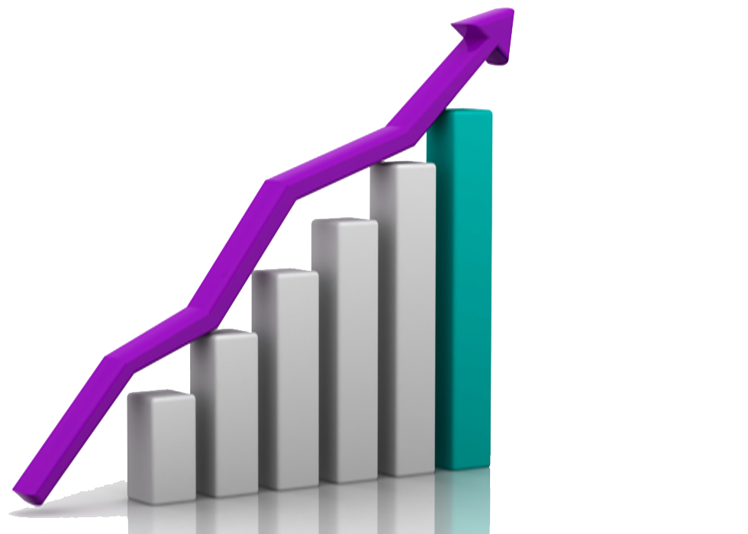

THE "WOW" IN OUR SOLUTION
Current employee rating in numerical values into words . Using IFS FORMULA
- VERY HIGH
- HIGH
- MEDIUM
- LOW
1 - VERY LOW
3/21/2024 Annual Review
10
This Photo by Unknown Author is licensed under CC BY-NC

Slide 11
MODELLING
DATA COLLECTION:
Dataset download from Edunet dashboard (KAGGLE).
Gather basic employee details like employee ID, first name, business unit, gender, performance score, employee type, etc.
FEATURE COLLECTION:
EMPLOYEE ID : A unique identifier for each employee
FirstName: The first name of the employee.
Business Unit : The business unit to which the employee belongs
Employee Status : The current status of the employee (e.g., Active, Inactive)
Employee Type : The type of employee (e.g., Full-time, Part-time).
Employee Classification Type : The classification of the employee
Gender Code: The gender of the employee (male, female).
Performance Score: The overall performance rating of the employee.
Current Employee Rating Level: The current numeric rating of the employee's performance.
11

Slide 12
3. DATA CLEANING:
Ensure data is accurate and consistent
Find out the missing values using conditional formatting.
Select the Range of Cells: Highlight the range of cells where you want to check for missing data (e.g., a column or entire table).
Open Conditional Formatting: Click on Conditional Formatting in the "Styles" group.
Alternatively, you can set the condition to Blanks: Select Blanks from the dropdown.
Format the Cells: Click on the Format... button. Choose a formatting style (e.g., fill the cell with a color, change the font color, etc.). Click OK.
Apply the Rule: Click OK again to apply the rule to the selected range.
4. REMOVE THE BLANK USING FILTER
Highlight the range of cells or the entire table where you want to remove blank values.
Go to the data tab. Click on Filter in the "Sort & Filter" group. This will add filter dropdown arrows to each column header.
Click the filter dropdown arrow in the column where you want to remove blank values
In the filter menu, uncheck the box labeled (blank) . This option will be near the bottom of the list.

Slide 13
6. SUMMARY:
Go to the Insert tab on the Excel ribbon. Click on PivotTable.
Insert the Pivot Table: In the dialog box, ensure the correct data range is selected.
Choose where you want the PivotTable to be placed in a new worksheet. Click OK.
Building the Pivot Table: After clicking OK, a new sheet will display an empty Pivot Table layout on the left and a PivotTable Fields pane on the right.
Add Fields to the Pivot Table:
Rows: Drag a field (e.g., Business unit) into the Rows area. This will list unique values from the selected field vertically.
Columns: Drag a field (e.g., gender) into the Columns area to create column headers.
Values: Drag a field (e.g. performance rating level) into the Values area Filters: Drag a field into the Filters area to create a filter for your Pivot Table. This allows you to filter the entire Pivot Table by that field.
7. DATA VISUALIZATION:
Insert a Chart :
Select Data: Highlight the data you want to visualize.
Insert Chart: Go to the Insert tab on the Excel ribbon. Choose the desired chart type from the Charts group (e.g., BAR CHARTS)
Excel will generate a basic chart based on your selected data.
Chart Title: Add a descriptive title by clicking on the default title and typing in your own.
Axis Titles: Add titles to the horizontal (X) and vertical (Y) axes to clarify what they represent.
Data Labels: Add data labels to show exact values on the chart.
Legend: Position the legend to the right, left, top, or bottom of the chart, or remove it if unnecessary.

Slide 14
RESULTS
14

Slide 15
CONCLUSION
To conclude The Employee Performance Analysis, it can be stated that the majority of employees fall within the Medium performance level. This indicates that while a significant portion of the workforce meets expectations and performs adequately, there is potential for development and improvement to elevate them to higher performance levels. This trend suggests the need for targeted training and development programs to enhance overall employee productivity and drive better outcomes for the organization.

